Slide 1
World History: Connection to Today
Chapter 1
Toward Civilization
(Prehistory–3000 B.C.)
Copyright © 2003 by Pearson Education, Inc., publishing as Prentice Hall, Upper Saddle River, NJ. All rights reserved.

Slide 2
World History: Connection to Today
Chapter 1: Toward Civilization
(Prehistory–3000 B.C.)
Section 1: Understanding Our Past
Section 2: The Dawn of History
Section 3: Beginnings of Civilization
Copyright © 2003 by Pearson Education, Inc., publishing as Prentice Hall, Upper Saddle River, NJ. All rights reserved.

Slide 3
Understanding Our Past
1
How are geography and history linked?
How do anthropologists and archaeologists find out about early peoples?
How do historians try to reconstruct the past?

Slide 4
Geography and History
1
Geography is the study of people, their environments, and the resources available to them.
History uses written evidence to tell us how people lived in the past.
By showing how people lived in different times and places, geographers have added to our knowledge
of human history.

Slide 5
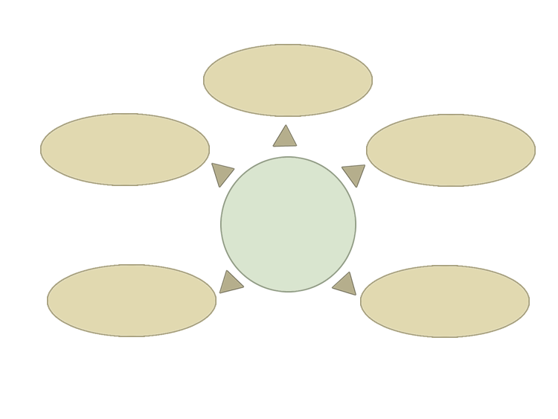
The Five Themes of Geography
1
Place
Movement
Region
The Human Story
Location
Human-environment
interaction

Slide 6
Anthropologists & Archaeologists
1
Anthropology is the study of the origins and development of people and their societies. Some anthropologists study the origins of human life. Others focus on the variety of human cultures.
Archaeology is a specialized branch of anthropology.
Archaeologists study artifacts, objects made by human beings. By analyzing artifacts, archaeologists learn about the beliefs, values, and activities of early people.

Slide 7
How Do Historians Reconstruct the Past?
1
Historians rely primarily on written evidence to determine how people lived in the past.
Recorded history began about 5,000 years ago, when people began to keep written records.
Today, historians study such evidence as photographs and film, as well as written documents such as letters and tax records.

Slide 8
Section 1 Assessment
1
Which of the following is not an example of an artifact?
a) clothing
b) weapons
c) rivers
d) tools
What do historians look at to learn how people lived in the past?
a) They focus on the environments in which early people lived.
b) They primarily look at written records.
c) They primarily dig for artifacts.
d) They primarily look at landforms.
Want to connect to the World History link for this section? Click Here.

Slide 9
Section 1 Assessment
1
Which of the following is not an example of an artifact?
a) clothing
b) weapons
c) rivers
d) tools
What do historians look at to learn how people lived in the past?
a) They focus on the environments in which early people lived.
b) They primarily look at written records.
c) They primarily dig for artifacts.
d) They primarily look at landforms.
Want to connect to the World History link for this section? Click Here.

Slide 10
The Dawn of History
2
What advances did people make during the Old Stone Age?
How can we learn about the religious beliefs of early people?
Why was the Neolithic agricultural revolution a turning point in history?

Slide 11
The Dawn of History
2
During the Old Stone Age, people lived as nomads, in small
hunting and food gathering groups. These people
made simple tools and weapons out of stone, bone, or wood;
developed a spoken language;
invented clothing;
used caves and rocky overhangs for shelter;
learned to build fires for warmth and cooking.

Slide 12
Early people left evidence of their belief in a spiritual world.
2
The Dawn of History
Stone statues are believed to have had religious meaning. Statues of pregnant women suggest that early people worshiped earth-mother goddesses.
Animism is the belief that the world
Is full of spirits and forces that might
reside in animals, objects, or
dreams.
Cave paintings may have been
part of animist religious rituals.
Early people began burying their dead with care, suggesting a belief in life after death. They provided the dead with tools and weapons for the afterlife.

Slide 13
The Neolithic Agricultural Revolution
2
The change from nomadic to farming life led to changes in the way people lived and to the emergence of civilizations.
PEOPLE BEFORE
PEOPLE AFTER
Relied on hunting and gathering.
Learned to farm and were able to produce their own food.
Nomads lived in small hunting and food-gathering groups.
Settled into permanent villages.
Waited for migrating animals to return each year.
Learned to domesticate, or tame, animals.

Slide 14
Section 2 Assessment
2
Which of the following suggests that early people held religious beliefs?
a) They buried their dead with tools, weapons, and other items needed in the afterlife.
b) They learned to produce their own food.
c) They developed a spoken language.
d) They lived in caves or under rocky overhangs.
Which was an advance of the Neolithic Agricultural Revolution?
a) Early people learned to gather nuts and berries.
b) Early people learned to hunt.
c) Early people learned to produce their own food.
d) Early people became nomads.
Want to connect to the World History link for this section? Click Here.

Slide 15
Section 2 Assessment
2
Which of the following suggests that early people held religious beliefs?
a) They buried their dead with tools, weapons, and other items needed in the afterlife.
b) They learned to produce their own food.
c) They developed a spoken language.
d) They lived in caves or under rocky overhangs.
Which was an advance of the Neolithic Agricultural Revolution?
a) Early people learned to gather nuts and berries.
b) Early people learned to hunt.
c) Early people learned to produce their own food.
d) Early people became nomads.
Want to connect to the World History link for this section? Click Here.

Slide 16
Beginnings of Civilization
3
How did the first cities emerge?
What are the basic features of civilizations?
How do cultures spread and change?

Slide 17
What Are the Basic Features of Civilizations?
3
Farmers began cultivating lands along river valleys
and producing surplus, or extra, food.
Surpluses helped populations expand.
As populations grew, some villages swelled
into cities.

Slide 18
What Are the Basic Features of Civilizations?
3
A civilization is a complex, highly organized social order.
Historians distinguish eight basic features found in most
early civilizations:
1. Cities
2. Well-organized central governments
3. Complex religions
4. Job specialization
5. Social classes
6. Arts and architecture
7. Public works
8. Writing

Slide 19
Civilizations Spread and Change
3
Civilizations spread when ancient rulers gained more power and conquered territories beyond the boundaries of their cities.
Civilizations change when the
physical environment changes.
Example: A tremendous volcano may have wiped out Minoan civilization.
Powerful rulers created city-states
and empires.
Interactions among people also
cause cultures to change.
A city-state included a city and
its surrounding lands and
villages.
Cultural diffusion is the spread
of ideas, customs, and technologies from one people to another. Cultural diffusion occurred through migration, trade, and warfare.
An empire is a group of states or
territories controlled by one
ruler.

Slide 20
Section 3 Assessment
3
Which of the following is not a feature of early civilizations? a) cities b) well-organized central government c) cultural diffusion d) public works
Cultural diffusion occurs through a) hunting and gathering. b) migration, civilization, and warfare. c) migration, trade, and warfare. d) religion, trade, and warfare.
Want to connect to the World History link for this section? Click Here.

Slide 21
Section 3 Assessment
3
Which of the following is not a feature of early civilizations? a) cities b) well-organized central government c) cultural diffusion d) public works
Cultural diffusion occurs through a) hunting and gathering. b) migration, civilization, and warfare. c) migration, trade, and warfare. d) religion, trade, and warfare.
Want to connect to the World History link for this section? Click Here.

